Slide 1
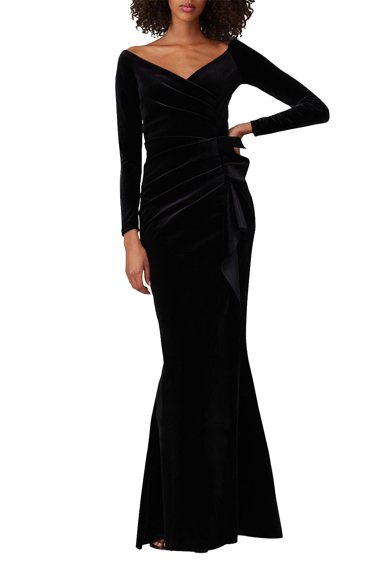

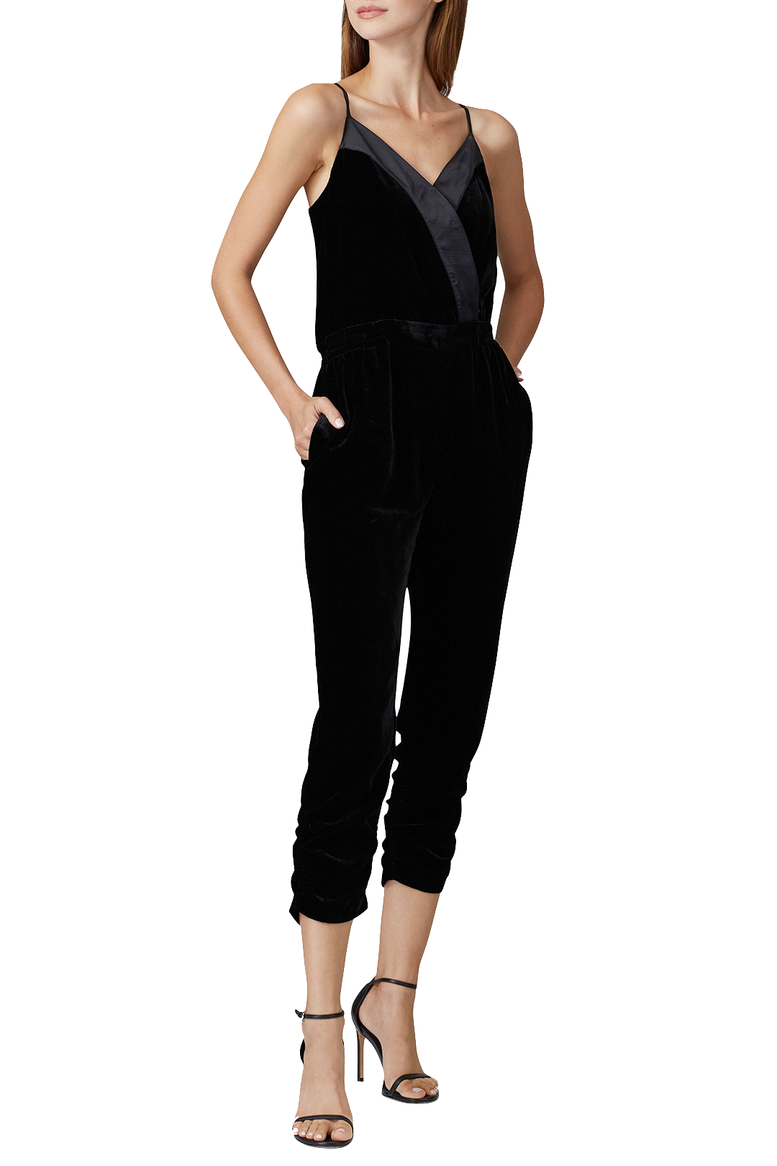
Recommend the Runway
Rent the Runway Pt. III
Lauren Schafrik

Slide 2
Overview
About RtR
Rent the Runway is a garment rental website, similar to Netflix’s DVD rentals, and founded in 2009 in order to bring empowerment and self-confidence to women by providing an unlimited closet with which users can freely express themselves and dress for success.
Goal
To build a recommendation system in order to more easily create and maintain a personal style
About the Data
Dataset is from Kaggle, which can be viewed here. The dataset has 192,544 total entries; each row corresponds with a user’s review of their garment rental, and includes their basic profile information.
The following highlighted columns were used over the course of this project:

Slide 3
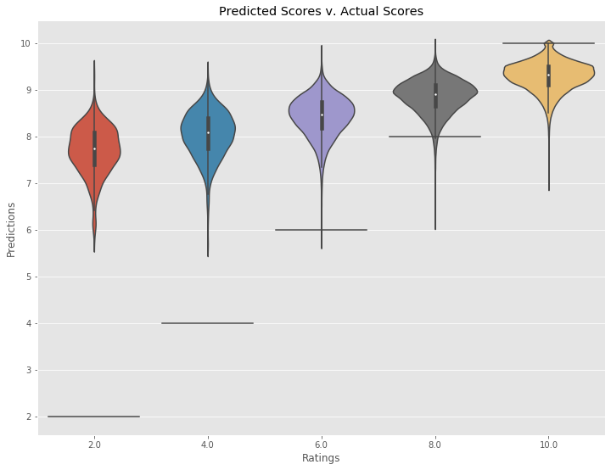
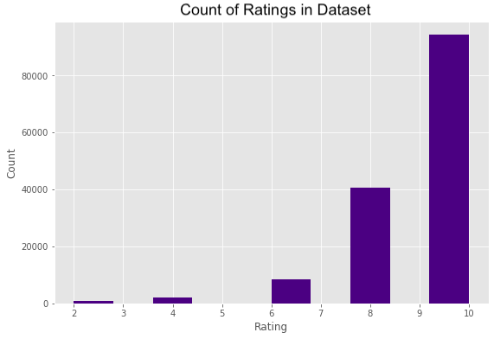
Model 1 - SVD Model (Surprise library)
The user is recommended items that people with similar tastes and preferences liked in the past. This method predicts unknown ratings by using the similarities between users
Surprise SVD model compared with Spark ALS model
SVD RMSE score of 1.4 v. ALS RMSE score of 1.9
SVD values can be negative or positive values; filled in missing values with ‘0’
Hyperparameters chosen via gridsearch
Model = SVD(lr_all=0.005, n_factors=25, reg_all=0.1)

Slide 4
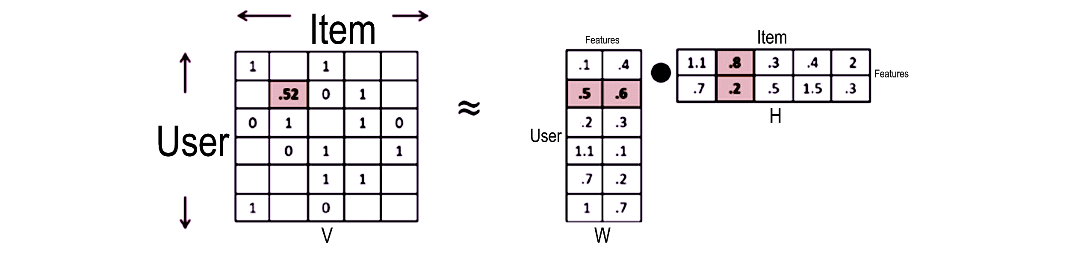
Model 2 - NMF Model (Sklearn library)
With NMF, all entries are non-negative, so we can see whether the rows or columns are part of a topic (features).
Hyperparameters chosen
N_components = 10 (latent features)

Slide 5
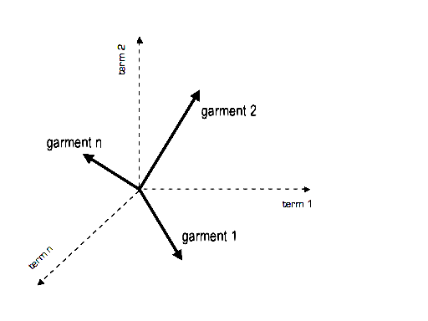
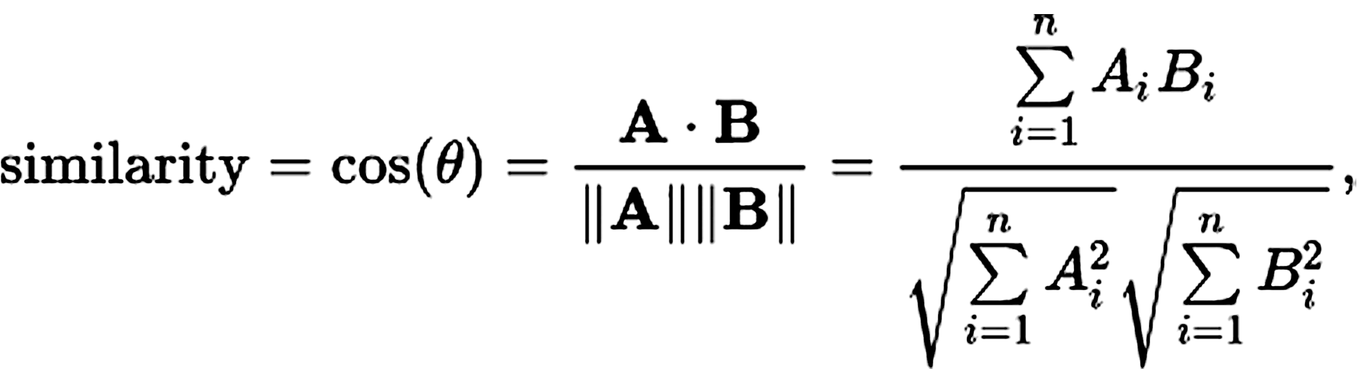
Model 3 - Item-Item Cosine Similarity
Looks for garments that are similar to the garments a specified user has already rated, and recommends the most similar garments
Features used in defining item similarity
Categories, rented_for, body_type

Slide 6
Outcome

Slide 7
What’s Next?
Problems faced
File sizes; computer unable to handle the data
Google Colab notebooks
Model hyperparameters
Item-Item features
Strengthening my project
Implement cold start
Improve the data
Designer and garment names
Moving to AWS
Surprise library

Slide 8




Recommend the Runway
Lauren Schafrik
Github: /lschafrik | Email: laurenabigail1993@gmail.com | LinkedIn: /lschafrik

